Slide 1
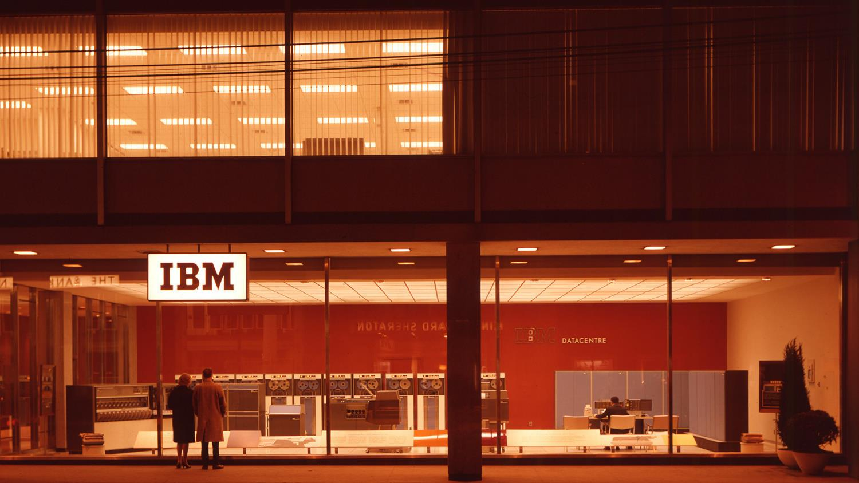
µ
The mainframe 2020 demo environment
Dennis Behm

Slide 2
Introduction to Mainframe 2020 scenario

Slide 3


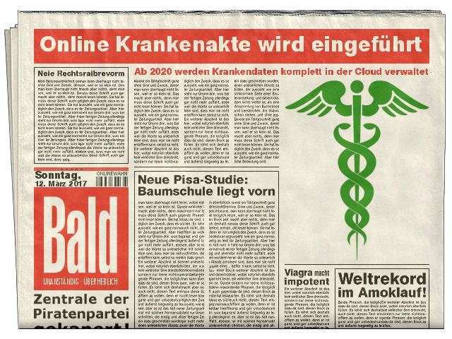
The scenario
OBILE INSURANCE
Mobile Insurance need to react to new German Law that wants to hold all health related records digitalized. Therefore the team of Mobile Insurance best people build a startup alike force that want to modernize the systems that interact with the health systems and also provide a new frontend for insurance agents as well as end users.
Notes:
This is our scenario: a German (health) insurance provider, that suddenly needs to implement access to their backend systems to establish a digital health record for every citizen

Slide 4

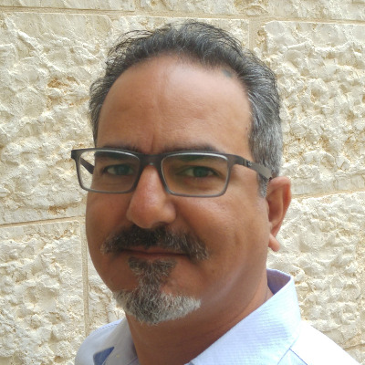




Personas
Mainframe Marcel– zOS guru and sysprog, infrastructure provider
DataBase Benedict – data base administrator and innovator
DevOps Dennis – master of devops and deployment
Reference Rami – application whisperer
Modernization Marianne – API designer and architect
Transaction Tommy/Torben – CICS/IMS developer
Bluemix Bob – Node and Java developer
Pension Pete - The previous sysprog handling the environment
Notes:
Meet the team.
Pension Pete is our previous sysprog who had kept the systems up and running, including provisioning.
Currently the position of Bluemix Bob is vacant, as our student moved on.

Slide 5
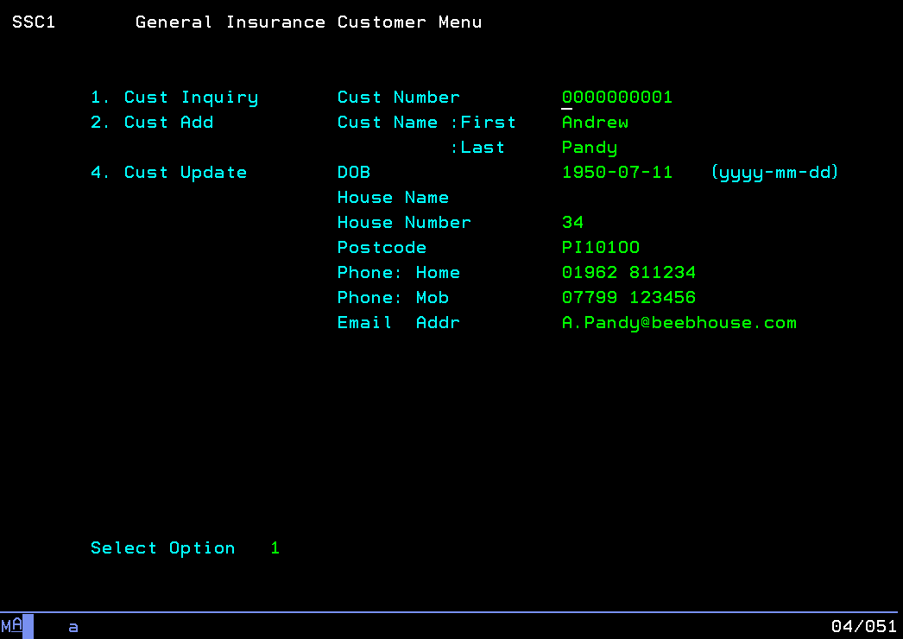
Where did we start?
Notes:
This is the customer database interface of the General Insurance Application

Slide 6
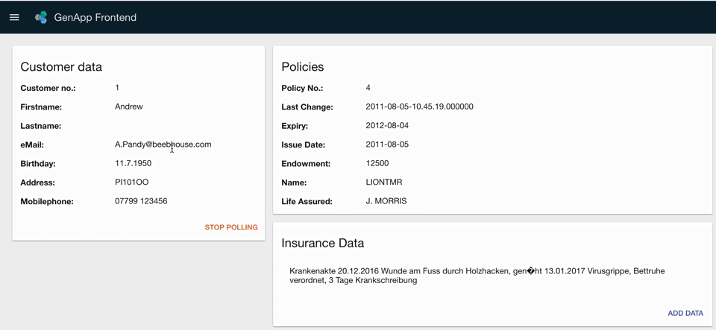
Back in 2017 … a modern UI in IBM Cloud accessing our core business logic on IBM Z
z/OS Connect
jax-rs in CICS Liberty
Blockchain
Notes:
The goal is a modern frontend that uses restful services to connect to the backend. We used the following options for demonstration purposes:
Java based restful services using the jax-rs framework in a Liberty server. This server could run standalone or integrated in CICS.
z/OS Connect as an alternative way of exposing mainframe assets as restful services
a Blockchain for the health record

Slide 7
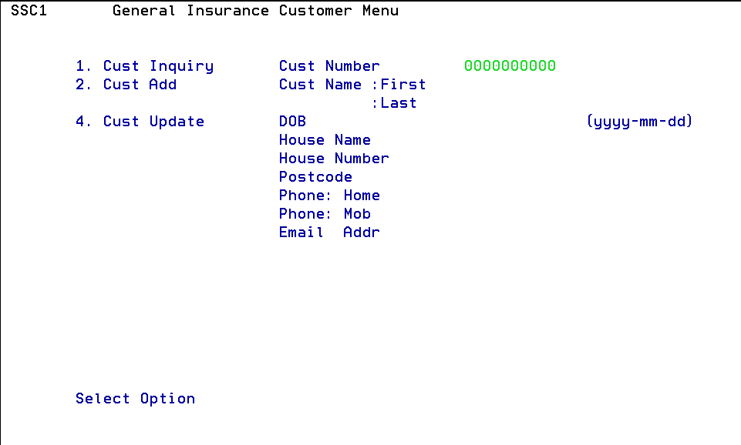
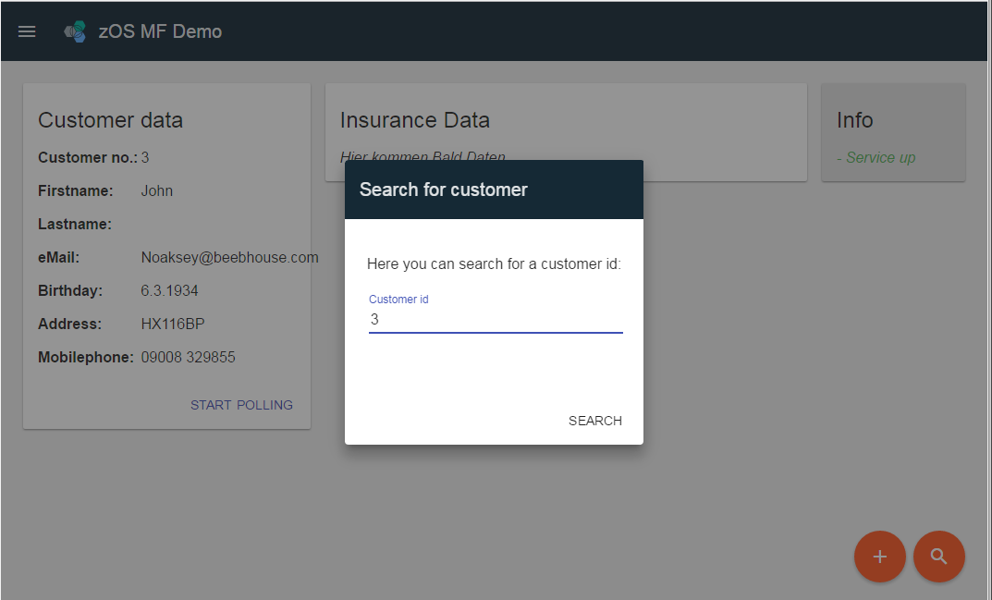
… and the full SDLC
Bluemix
Bluemix App
Private Network
RHEL
zOS
Urban Code Deploy
CICSDM01
GENAPP
Rational Team Concert
CICSL***
GENAPP
Liberty
CICSL***
Text to Speech
Call Mainframe
GENAPP
Ubuntu on z
Liberty
Hyperledger
CICSL***
GENAPP
Secure Gateway
zOS Connect
zOS MF
-> Cloud Provisioning
zOS Provisioning Toolkit
DB2
Secure Gateway Client
Watson Services

Slide 8
The provisioning aspect
Developers have a self-service marketplace in Z/OS Management Facility to request their isolated test environment.
Additionally they can use Z/OS Provisioning Toolkit to create a new execution environment.
The workflows were extended to let UrbanCode Deploy know about the new environment.
z/OSMF Cloud Provisioning
CICS001
Liberty
{rest} API
z/OS Connect
CICS002
CICS002
Schema 001
LOADLIB
002
Self-service Portal
LOADLIB
003
LOADLIB
CICS
Schema
LOADLIB
Notes:
The new environment takes advantage of the z/OSMF Cloud Provisioning, which comes free as part of the operating system.
People mostly use z/OSMF today for sending incident logs to IBM or to define their IP stack. There is much more available like WLM, Software Deployment, Tenant Groups for Container based pricing, Workflows, etc
And a lot of stuff is restfully accessible. In addition there is a simple self-service portal for demonstration purposes.
We now provision
CICS
Liberty Server (embedded in CICS, could be stand-alone)
z/OS Connect (could run in standalone Liberty server, we run it in the embedded Liberty)
user load lib
Db2 schema

Slide 9
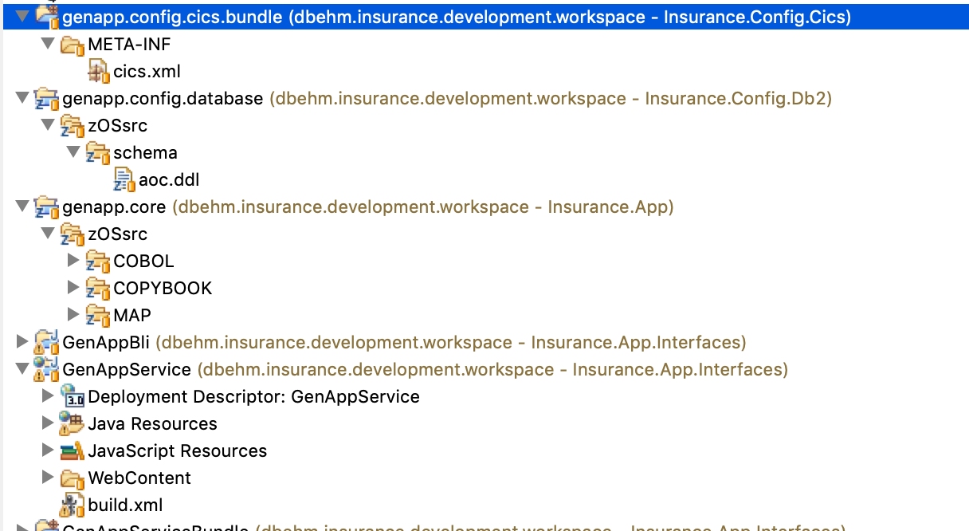
The pipeline aspect
We have started using IBM Rational Team Concert Enterprise Extensions to store and build all application source code including
The COBOL Backend Application including Cobol, Copybooks
Configuration files like
DDL for setting up the database
CICS Config
The JAX-RS JAVA Application for Liberty

Slide 10
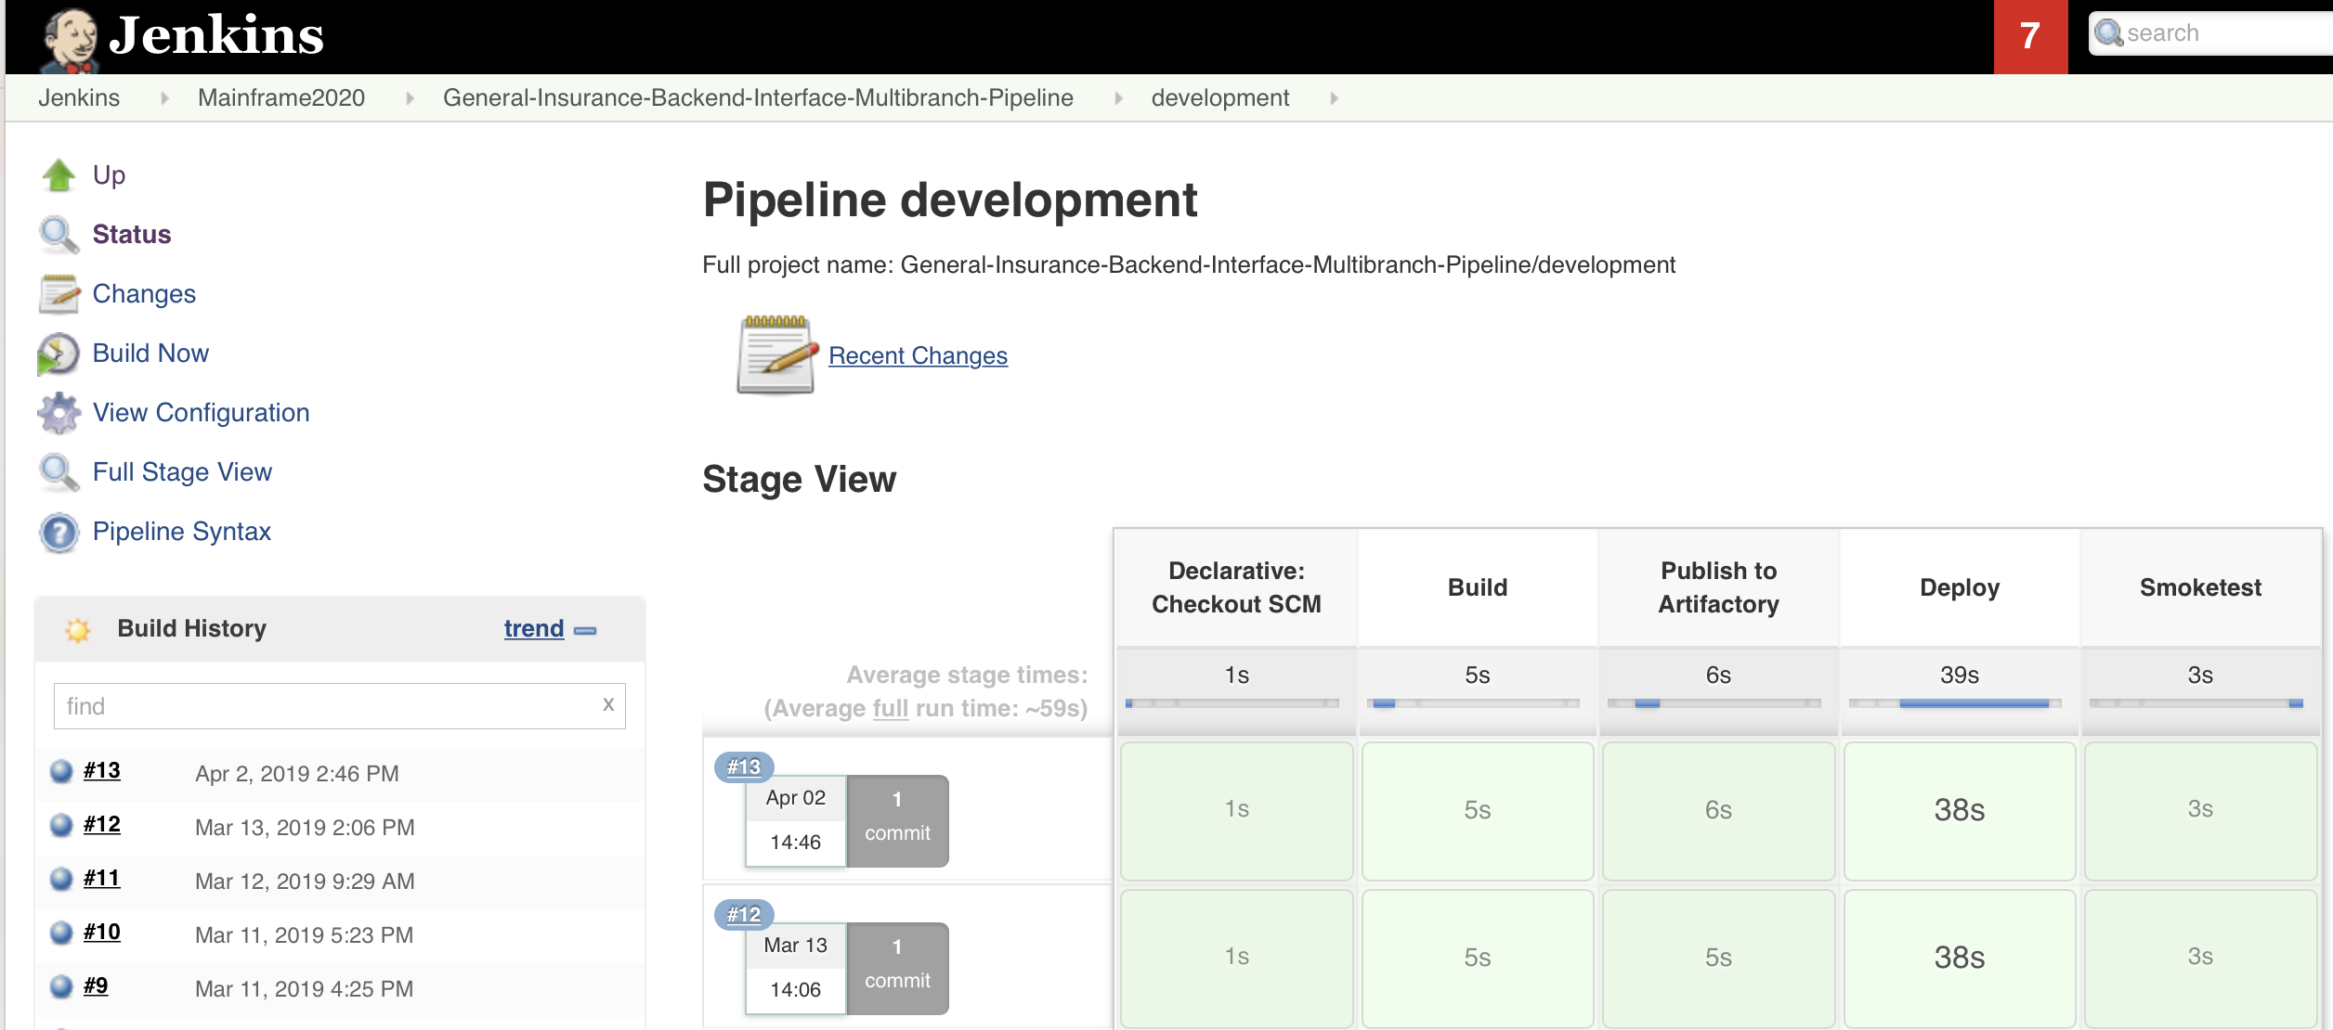
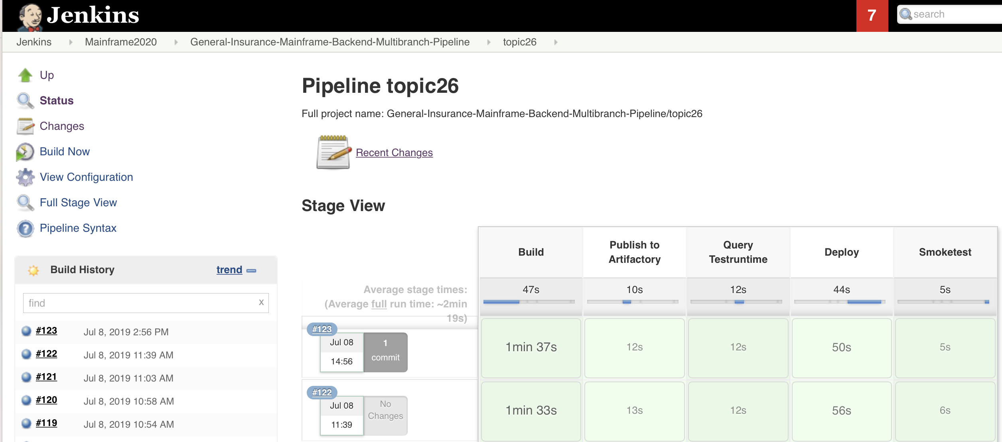
Migration to git/Jenkins/dbb/artifactory
Intern Jakob Naucke has migrated the COBOL source code to github and build two multibranch pipelines for the JAX-RS application and the GENAPP CICS Backend

Slide 11
Demo Part 1 – Infrastructure provisioning through z/OS Provisioning Toolkit

Slide 12
Demo Part 1: Provisioning through zospt
In 2017/2018 we had a strong focus to address the infrastructure perspective of a pipeline – to isolate from the execution perspective
Demoing Self-provisioning of an execution environment was key
At the same time, we continuously had the discussion to manage application specific configurations (like DDL, CICS defs) as code, sitting in the same version control system like the applications source code

Slide 13
zospt: preparing
Live Demo backup
DBEHM:/ZT01/var/ucd/v6.2.5/ucd-integration: >zospt ps
2019-07-15 11:04:58 IBM z/OS Provisioning Toolkit V1.1.4
2019-07-15 11:04:59 Connecting to z/OSMF on host localhost port 60443.
NAME IMAGE OWNER CREATED STATE TEMPLATE SYSTEM CONTAINER TYPE
REG-MQ_MQSYS00 N/A amreinm 2018-02-27T13:31:50 provisioned MQ_Registration ZT01 Standard
REG-DB2_DB2SYS00 N/A clpadmu 2018-06-26T12:02:49 provisioned DB2_Registration ZT01 Standard
REG-DB2_DB2SYS01 N/A clpadmu 2018-06-26T12:06:57 provisioned DB2_Registration ZT01 Standard
REG-MQ_MQSYS01 N/A amreinm 2019-02-11T09:09:22 provisioned MQ_Registration ZT01 Standard
CICS_CICSN000 devenvironment arnold 2019-04-01T13:23:16 provisioned cics55_DEMOPLX_devops ZT01 Standard
CICS_CICSN002 devenvironment dbehm 2019-07-04T13:44:29 provisioned cics55_DEMOPLX_devops ZT01 Standard
CICS_CICSN001 devenvironment dbehm 2019-06-17T09:08:22 provisioned cics55_DEMOPLX_devops ZT01 Standard
DBEHM:/ZT01/var/ucd/v6.2.5/ucd-integration: >
Notes:
live demo, slides are for reference and failover

Slide 14
zospt: provisioning (1)
Live Demo backup
DBEHM:/ZT01/var/ucd/v6.2.5/ucd-integration: >zospt images
2019-07-15 11:06:29 IBM z/OS Provisioning Toolkit V1.1.4
IMAGE NAME CREATED SIZE
cics.55.devops 2019-03-07T13:41:10 10240B
cics.55.devops.liberty 2019-03-07T13:41:12 10240B
cics.55.devops.zosconnect.v3r0 2019-03-07T13:41:15 20480B
cics_52 2019-03-07T08:29:50 10240B
cics_53 2019-03-07T08:29:50 10240B
cics_54 2019-03-07T08:29:50 10240B
cics_55 2019-03-07T08:29:50 10240B
cics_55_json 2019-03-07T08:29:50 10240B
cics_55_liberty 2019-03-07T08:29:50 10240B
cics_55_nodejs_ivp 2019-03-07T08:29:50 20480B
cics_55_soap 2019-03-07T08:29:50 10240B
cics_55_zosconnect_v3r0 2019-03-07T08:29:50 20480B
cics_async_api_sample 2019-03-07T08:29:50 235520B
cics_getting_started_cloud 2019-03-07T08:29:50 10240B
cics_getting_started_workflow 2019-03-07T08:29:50 10240B
cmas_55 2019-03-07T08:29:50 10240B
devenvironment 2019-03-07T13:41:17 30720B
rsdemo_fi 2019-04-16T15:22:12 10240B
rsdemo_fiadv 2019-04-16T15:27:44 471040B
rsdemo_linz 2019-03-29T16:03:56 471040B
wui_55 2019-03-07T08:29:50 10240B
zosconnect_v2r0 2019-03-07T08:29:50 10240B
zosconnect_v3r0 2019-03-07T08:29:50 10240B
Notes:
live demo, slides are for reference and failover

Slide 15
zospt: provisioning (1/2)
Live Demo backup
DBEHM:/ZT01/var/ucd/v6.2.5/ucd-integration: >zospt-samples.sh
zospt run devenvironment and link to db2
2019-07-15 11:07:27 IBM z/OS Provisioning Toolkit V1.1.4
2019-07-15 11:07:27 Running image devenvironment.
2019-07-15 11:07:28 The z/OSMF template used is cics55_DEMOPLX_devops.
2019-07-15 11:07:28 The z/OSMF domain is default.
2019-07-15 11:07:28 The z/OSMF tenant is Dev_North.
2019-07-15 11:07:28 Connecting to z/OSMF on host localhost port 60443.
2019-07-15 11:07:32 The z/OSMF template cics55_DEMOPLX_devops was created by CLPADMU at 2019-04-01T13:04:28.403Z. The template type is standard. It was last modified by CLPADMU at 2019-04-01T13:20:10.212Z.
2019-07-15 11:08:03 Creating container CICS_CICSN003 with id 86902e17-9378-4289-844c-1ebd454325a6 on system ZT01.
2019-07-15 11:08:06 Getting DB2 object id - Complete.
2019-07-15 11:08:09 Getting necessary DB2 data - Complete.
2019-07-15 11:08:11 Getting dynamic APPLID - Complete.
2019-07-15 11:08:11 Calculating CICS SYSID - Complete.
2019-07-15 11:08:17 Validating access to CICS data sets - Complete.
2019-07-15 11:08:21 Validating access to zFS directories - Complete.
2019-07-15 11:08:23 Validating shared CSD - Complete.
2019-07-15 11:08:27 Validating console commands can be issued - Complete.
2019-07-15 11:08:27 Hardening state indicating template validation steps passed. - Complete.
2019-07-15 11:08:31 Obtaining CICS version and hostname for the LPAR - Complete.
2019-07-15 11:08:42 Allocating HTTP port - Complete.
2019-07-15 11:08:45 Allocating HTTPS port - Complete.
2019-07-15 11:08:49 Creating CICS region data sets - Complete.
2019-07-15 11:09:07 Creating the zFS directory for the CICS region - Complete.
2019-07-15 11:09:10 Formatting CICS region data sets - Complete.
2019-07-15 11:09:14 Creating CICS log stream model - Complete.
Notes:
live demo, slides are for reference and failover

Slide 16
zospt: provisioning (2/2)
Live Demo backup
2019-07-15 11:09:19 Creating CICS security configuration - Complete.
2019-07-15 11:09:22 Creating CICS system definition - Complete.
2019-07-15 11:09:26 Setting directory permissions - Complete.
2019-07-15 11:09:30 Creating CICS CSD definitions - Complete.
2019-07-15 11:09:33 Creating the CICS region JCL - Complete.
2019-07-15 11:09:37 Allocating User datasets - Complete.
2019-07-15 11:10:06 Creating an Urban Code Deploy Environment - Complete.
2019-07-15 11:10:07 DFH_JVM_DEBUG : NO
2019-07-15 11:10:07 DFH_REGION_TCPIPPORT : 3045
2019-07-15 11:10:07 DFH_REGION_CMCIPORT : 3050
2019-07-15 11:10:07 DFH_REGION_IPIC : NO
2019-07-15 11:10:07 DFH_REGION_APPLID : CICSN003
2019-07-15 11:10:07 DFH_REGION_HTTP : 54206
2019-07-15 11:10:07 DB2_REGISTRY_NAME : REG-DB2_DB2SYS00
2019-07-15 11:10:07 DFH_REGION_HTTPS : 54207
2019-07-15 11:10:07 DFH_CICS_TYPE : MAS
2019-07-15 11:10:07 DFH_REGION_ZFS_DIRECTORY : /var/cicsts/CICSN003
2019-07-15 11:10:07 DFH_CMAS_SYSID : CPLX
2019-07-15 11:10:07 DFH_CICSPLEX : DEMOPLX
2019-07-15 11:10:07 DFH_REGION_HOSTNAME : ZT01.moppssc.com
2019-07-15 11:10:07 DFH_CICSGRP : DEFAULT
2019-07-15 11:10:07 DFH_CMAS_APPLID : CPSMCMAS
2019-07-15 11:10:09 Created container CICS_CICSN003 with id 86902e17-9378-4289-844c-1ebd454325a6 on system ZT01.
2019-07-15 11:10:11 Performing start on container CICS_CICSN003.
2019-07-15 11:10:15 Checking zFS is mounted - Complete.
2019-07-15 11:10:42 Container CICS_CICSN003 has been started.
Notes:
live demo, slides are for reference and failover

Slide 17
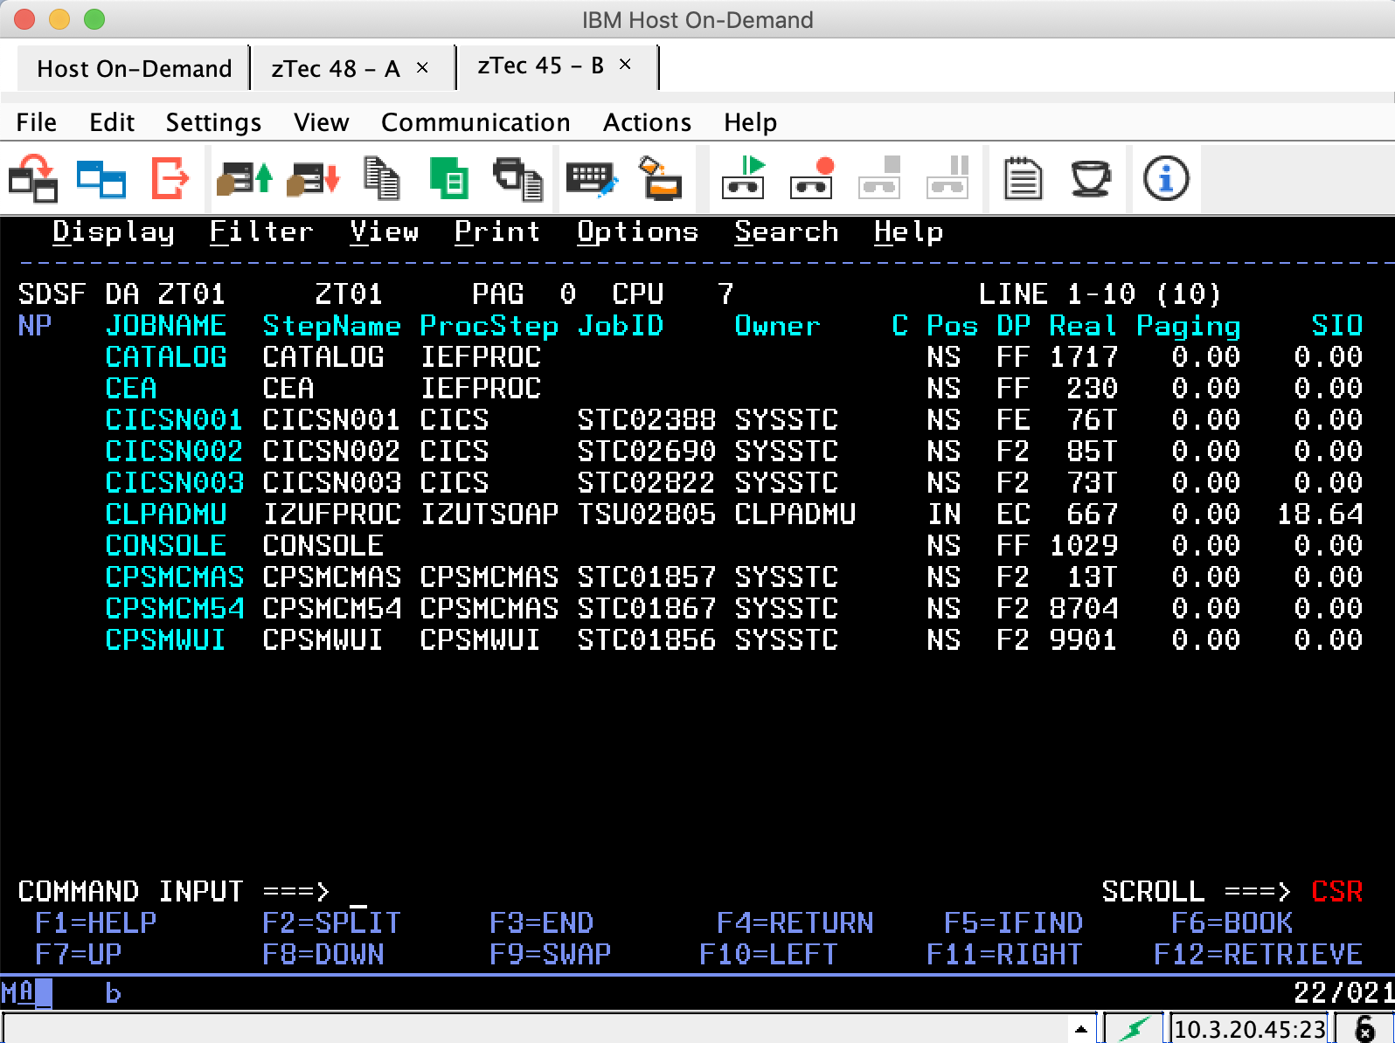
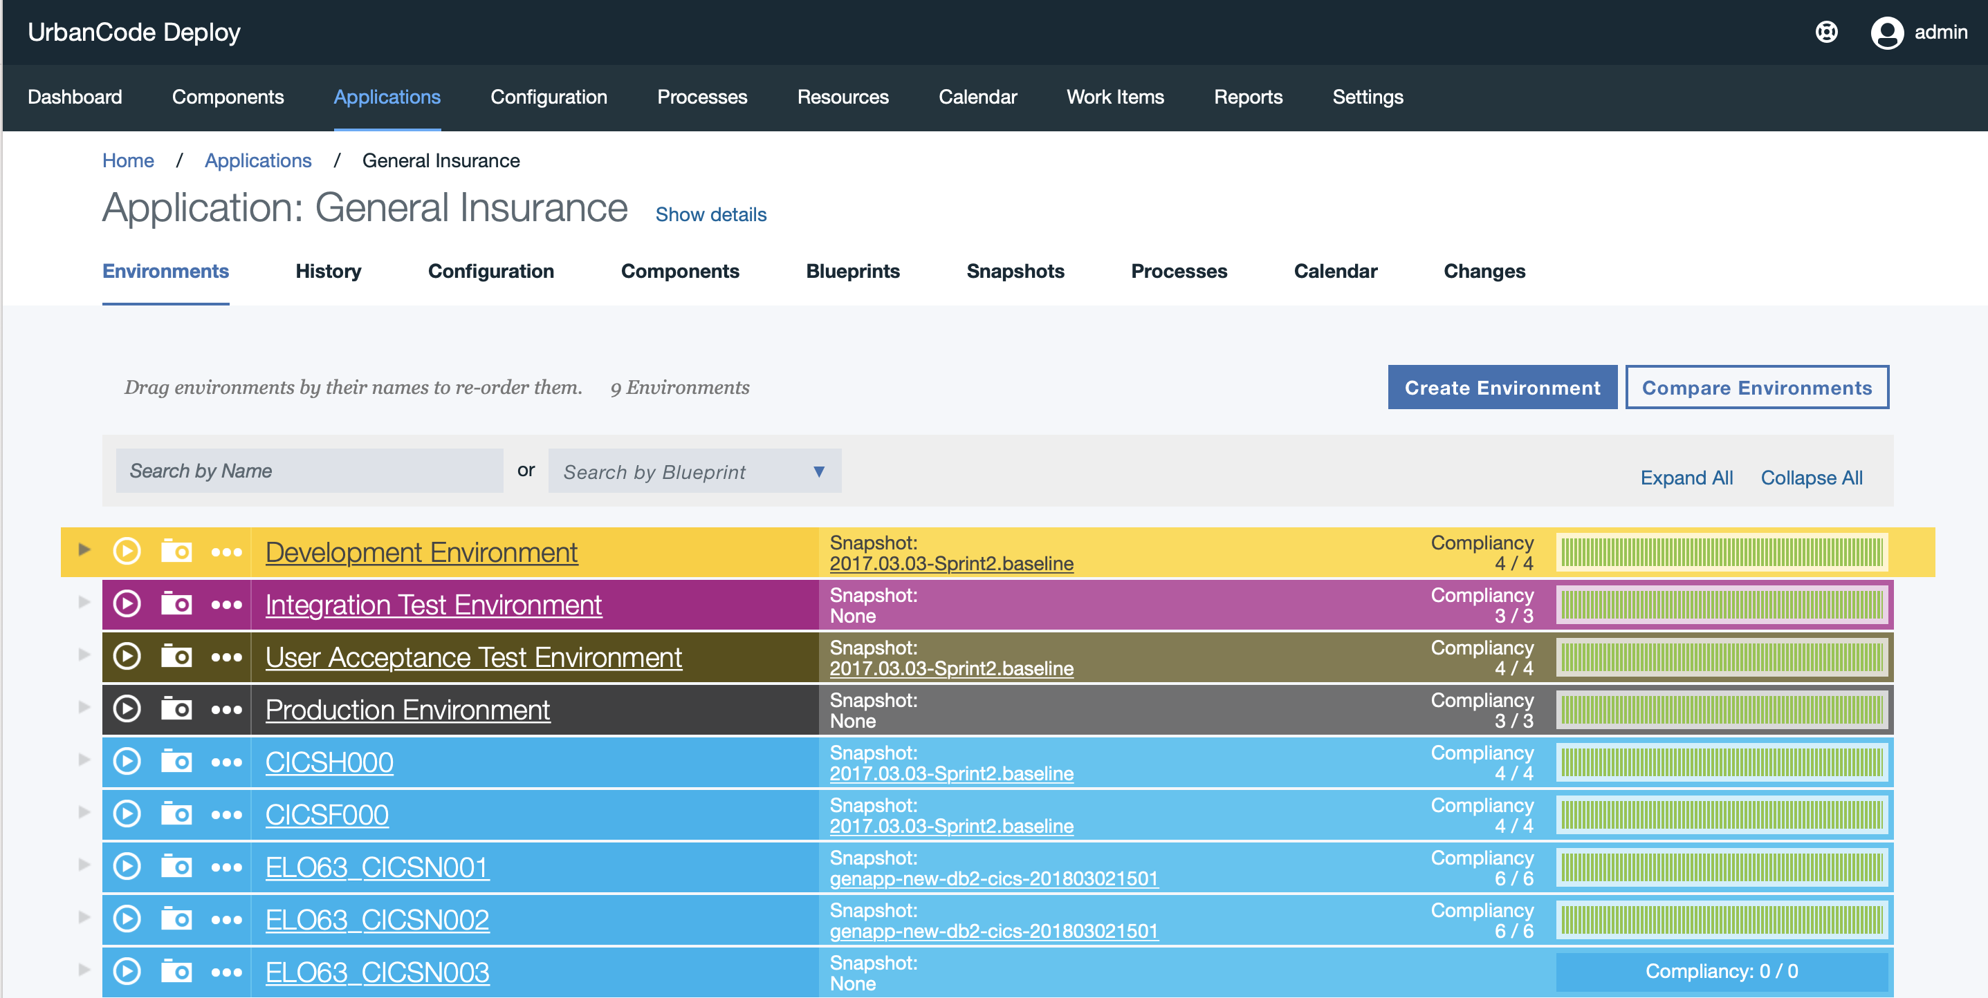
A new empty execution environment
The workflows created a new CICS Region
Linked the environment to an existing DB subsystem
And made the environment visibile in UCD

Slide 18
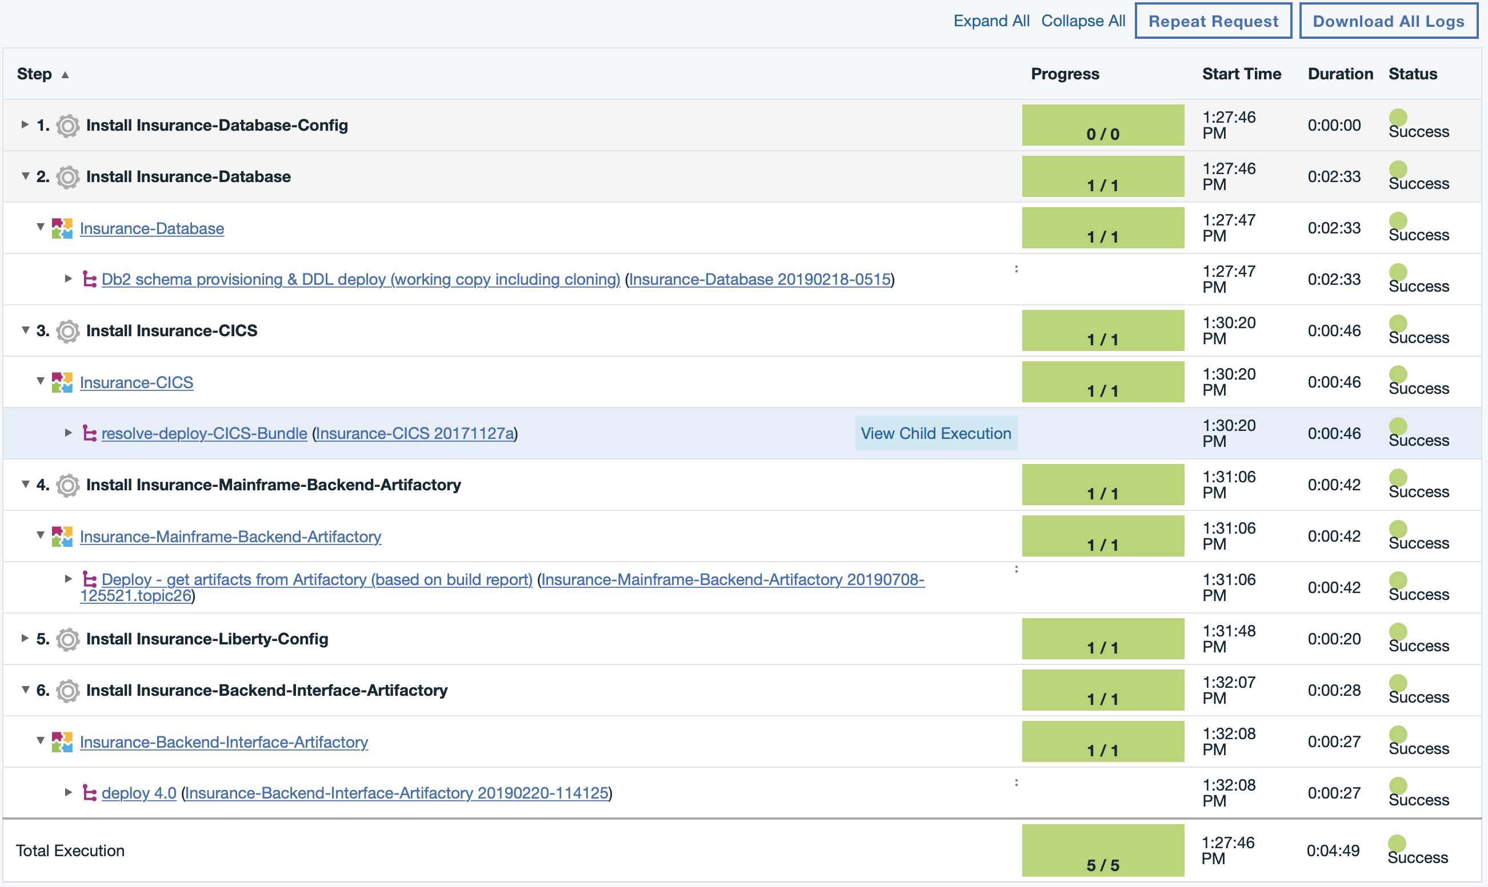
Deploying a application baseline
For demoing purposes this is performed through the UI, explaining the different applications components which made up our demo environment.
It does not include the deployment of the frontend in IBM Cloud

Slide 19
Demo Part 2 – Open Pipeline Demo

Slide 20









Open Pipeline build scenario – Overview Edit & check-in → Pipeline → Build → Publish → Deploy & Test
1
2
3
4
5
IDE
Pipeline
Orchestrator
Artifact Repository
Deployment Manager
2
IBM Z Open Development
Jenkins Server
JFrog Artifactory
(OSS)
UCD Server
3
Editors
SCM
Build
5
Central” git Repository
DBB Server
E-Git Plugin
DBB User Build
Deployment Automation
1
CPY-1
Build Machine
Unix System Services
MVS
*bins
UCD Agent
PGM-A
CPY-2
Jenkins Agent ‘Task’
4
git cmdline
File System (PDS)
*metadata
Build Scripts (Groovy)
DBB Toolkit API
RSE
Notes:
Blue highlights the components on Z/OS

Slide 21
Details
Jenkins Multibranch Pipeline setup
Leading to dedicated build environment per branch (happening on LPAR *.48)
Dedicated package including reference to branch based on naming conventions
Packaging and deployment uses dbb’s buildreport as the descriptor of the package
We know, that we keep more information then necessary
We run full builds
Separation of holding the binaries in Artifactory and UCD as the Deployment Manager to retrieve and install
Faked Step to “Query Runtime environment”
Utilities a simple JSON as a mapping Branch <> Execution environment

Slide 22
Gap Analysis

Slide 23
Application Scope
Dimension |  | THINK19 - Genapp | Mainframe2020
Application scope
 | App Backend | COBOL/CICS GenApp Sample | COBOL/CICS GenApp Sample
 | App Middle tier | - | JAX-RS application providing a REST interface
 | App Frontend | - | IBM Cloud Cloud Foundry, using Secure Gateway to access On-Prem infrastructure
Application configuration
 | Db2 definitions | - | DDL stored in RTC, being deployed through UCD
 | CICS definitions | - | CICS bundle stored in RTC, being deployed through UCD

Slide 24
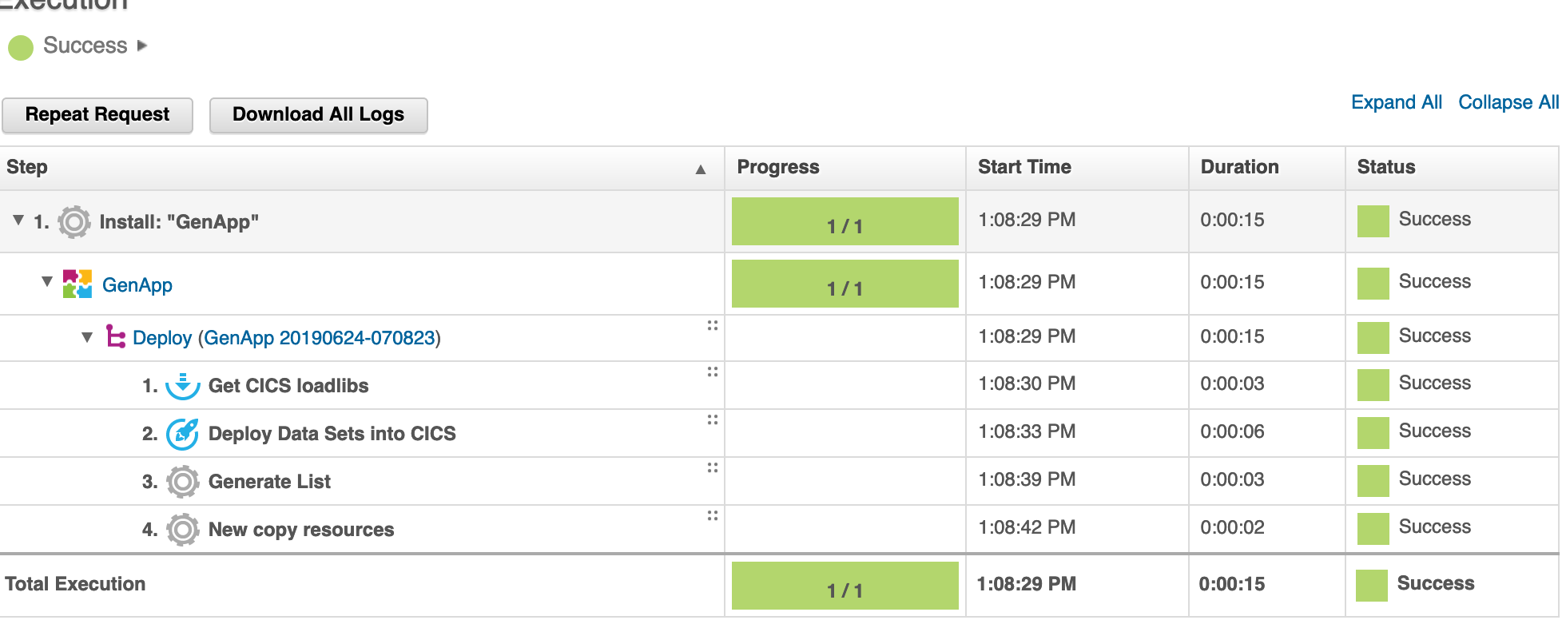
Pipeline aspects
Dimension |  | THINK19 - Genapp | Mainframe2020
Pipeline aspects
 | Build environment | Separate Libraries for Pipeline Build NAZARE.MASTER.GENAPP, but a shared environment for pull requests NAZARE.PR.GENAPP, no concurrency! zUnit and Sonarqube well integrated, but would like to see this also as part of the pull request | Each identified branch receives a dedicated build environment
 | Packaging | Incremental Packages on PRs stored in Artifactory based on the YAML file | Full packages stored in Artifactory, UCD components reference binaries in Artifactory, follow same naming conventions
 | Provisioning | None | Big focus on Provisioning in 2017/2018, not fully included in the GitHub pipeline setup, but in the IBM pipeline
 | Deployment | For pull requests UCD triggers shellscript on zD&T For branch pipeline the deployment happens through UCD plugins | Deployment

Slide 25
Workflow aspects
Dimension |  | THINK19 - Genapp | Mainframe2020
Workflow aspects
 | Parallel development | Working in branches ideally explains the concept of isolation on the VCS | Working in branches explains the concept of isolation on the VCS, no yet implemented for the configuration elements of the application Provisioning of an execution runtime and integration into UCD explains the isolation from a infrastructure perspective
 | Approval Workflow | Concept of pull requests focusses on the regulatory requirements; is key to understand. | -
 | User acceptance workflows | Interaction with line of business is unclear in both demos
 | Performance | Build for Pull requests taking 5 minutes is not acceptable | Very fast, everything on z Hardware

Slide 26

Dennis Behm
Senior Client Technical Specialist for DevOps for IBM Z
📞 0160 - 90790758
✉ dennis.behm@de.ibm.com

